Slide 1

NAME: DUSHIME Sangwa Bertrand
ID: 27971
Course: PL/SQL Database
Date: December ,9th ,2025
Group: Wednesday ( C )
Institute: ADVENTIST UNIVERSITY OF CENTRAL AFRICA
Project Name: Medicine Batch Entry and Validation System (Med-Enter)

Slide 2

Table of Contents: Med-Enter System
Slides: Description
Slide 1: .................................. Title
Slide 2: .................................. Table of content
Slide 3: .................................. Problem
Slide 4: .................................. Solution
Slide 5: .................................. Database
Slide 6: .................................. Business Process
Slide 7: ...................................Technical
Slide 8: .................................. Advanced Features
Slide 9: .................................. Results
slide 10: ................................ Conclusion

Slide 3
SLIDE 3: PROBLEM
Issue (Problem): Traditional, multi-step manual inventory entry processes are prone to human error.
Context: Pharmacists/inventory staff receiving new medicine shipments.
The Critical Risk: Without immediate, enforced validation, expired or near-expiry medicine can be accidentally accepted into the inventory, compromising patient safety and leading to financial loss.
Users: Pharmacist/Staff .

Slide 4

SLIDE 4: SOLUTION
· Objective: To create a secure and efficient method for staff to enter new supplies, ensuring immediate and automated validation against critical safety rules.
· Scope: End-to-end process from receiving a physical shipment to the final, validated update of the digital inventory.
· Core Feature: Centralizing all logic (validation, stock update, logging) into a single, atomic, transactional PL/SQL Stored Procedure (ADD_NEW_MEDICINE_BATCH).
· Innovation: Replacing multi-step manual checks with one secure, automated database operation.

Slide 5

SLIDE 5: DATABASE
Entity | Primary Purpose | Key Columns (PK/FK)
MEDICINES | Master reference, drug names, and reorder settings. | med_id (PK), reorder_level.
BATCH_INVENTORY | Detailed stock tracking by batch and expiry date. | batch_id (PK), med_id (FK), expiry_date.
ALERTS_LOG | Audit trail for all system events and warnings. | alert_id (PK), med_id (FK), alert_type¹⁹.

Slide 6
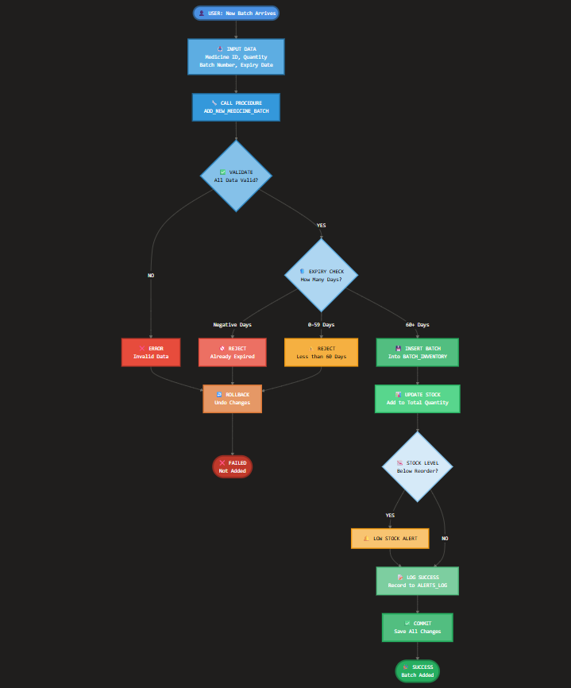
SLIDE 6: BUSINESS PROCESS
FLOWCHART IMAGE
Focus: The New Medicine Batch Receipt and Validation Process.
Swimlanes:
Pharmacist/Staff (User): Enters batch details (ID, Quantity, Batch No., Expiry Date).
PL/SQL Stored Procedure (System): Runs ADD_NEW_MEDICINE_BATCH.
Oracle Database (System): Stores data and manages transactions.
CONTENT

Slide 7
SLIDE 7: TECHNICAL
Technology: Oracle Database (PDB) and PL/SQL.
Core Logic: The ADD_NEW_MEDICINE_BATCH procedure.
Input Parameters: p_med_id, p_quantity, p_batch_number, p_expiry_date.
Output Parameters: p_status (SUCCESS/ERROR), p_message.
Expiry Logic (check_expiry_date function):
Evaluates remaining days until expiry to return one of three statuses:
EXPIRED (Negative Days)
NEAR_EXPIRY (0-59 Days)
VALID (60+ Days)

Slide 8
SLIDE 8: ADVANCED FEATURES
Auditing: All system events are recorded in the ALERTS_LOG.
Alert Types include BATCH_ADDED, EXPIRED_BATCH_REJECTED, NEAR_EXPIRY_REJECTED, and LOW_STOCK.
Reorder Level Check: Automatically triggered after a successful update to total stock.
If total_quantity falls below reorder_level, a LOW_STOCK alert is logged.
Security/Integrity:
Uses Foreign Key Constraints to ensure referential integrity between MEDICINES and BATCH_INVENTORY.
Transaction Control (COMMIT/ROLLBACK): Ensures that inventory changes only occur if all validation checks pass

Slide 9
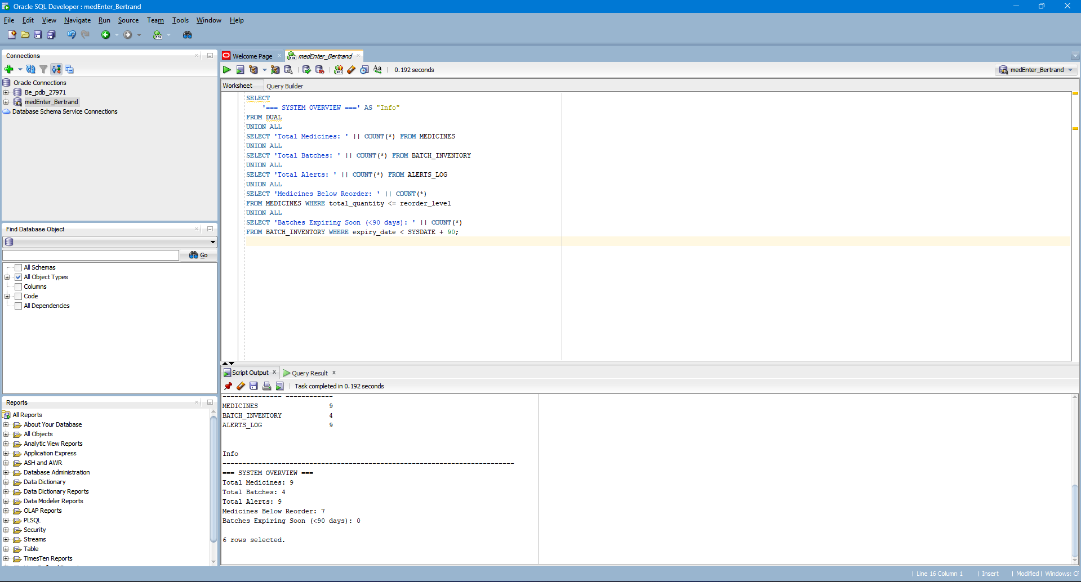
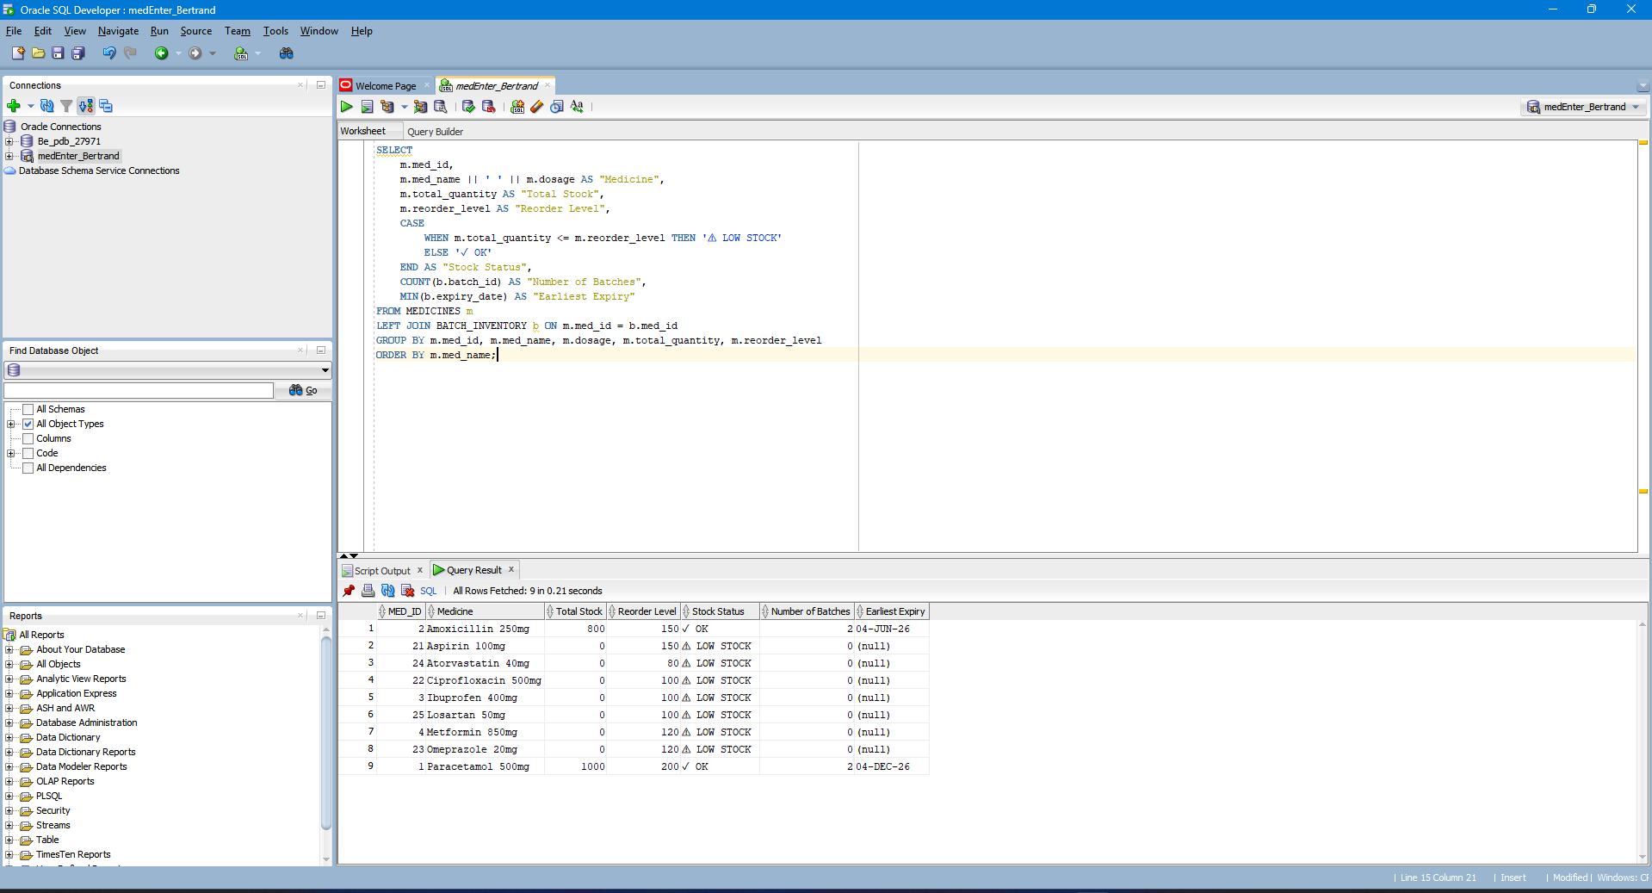
SLIDE 9: RESULTS
I. Data Volume: (Refer to record count in each table image)
MEDICINES: 9 records.
BATCH_INVENTORY: 5 records.
ALERTS_LOG: 9 records.
II. Screenshots:
System Overview: (system overview.png) to show current metrics.
Complete Inventory View: (complete inventory overview.png) to show aggregated totals and stock status.
SYSTEM OVERVIEW
COMPLETE INVENTORY OVERVIEW

Slide 10
tHANK YOU!
SLIDE 10: CONCLUSION
Achievements: The Med-Enter system successfully developed a robust, safety-focused, and automated inventory solution using PL/SQL.
Lessons Learned: The power of centralized PL/SQL logic for ensuring data integrity and enforcing critical business rules atomically (transaction control).
DONE BY BERTRAND DUSHIME SANGWA -27971

